Slide 1
Adoption of AI electron microscope
Jimin Han

Slide 2

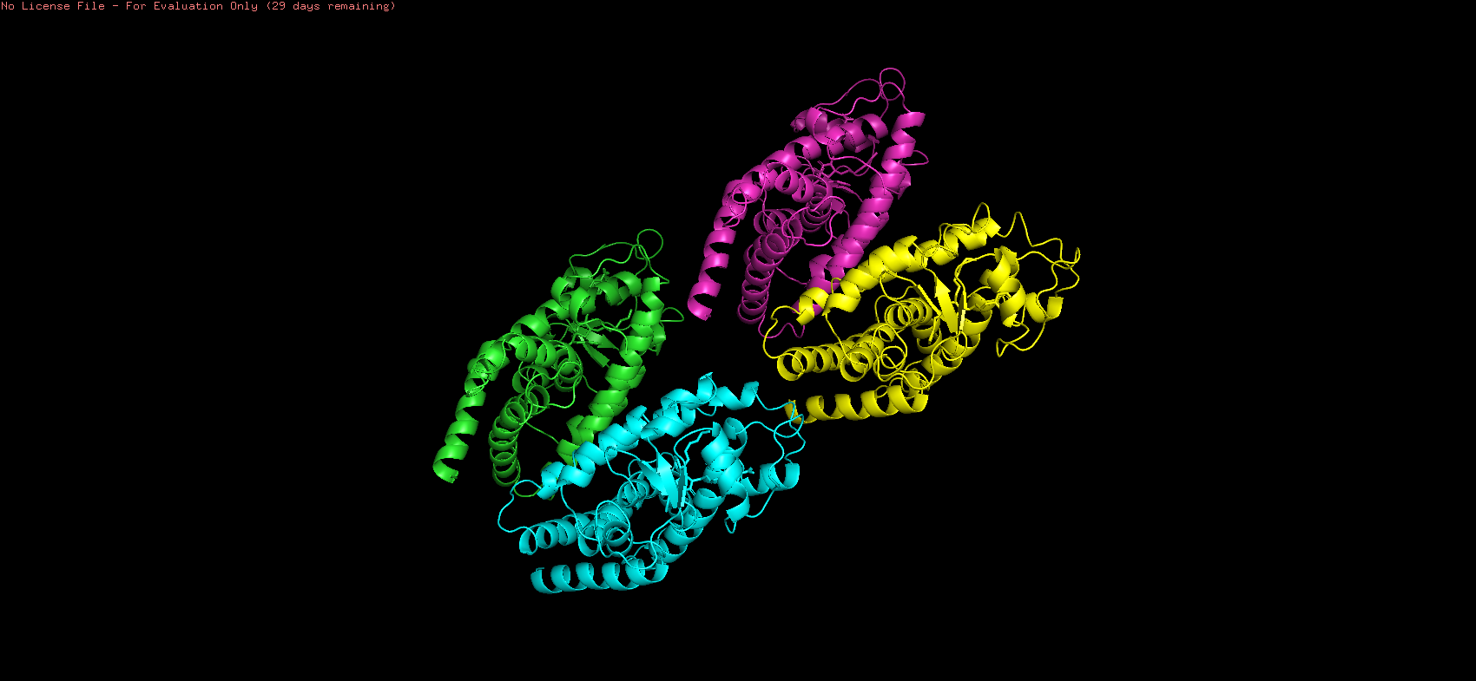
Introduction
People in the field of structural biology are constantly replacing, analyzing, and verifying laboratory tools in order to analyze experiment results every day. This definitely takes a considerate amount of time to do the final modeling.

Slide 3
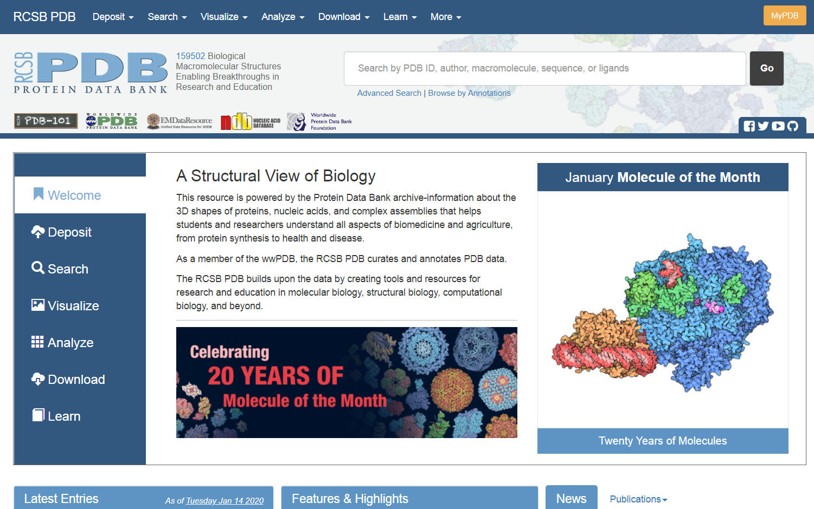

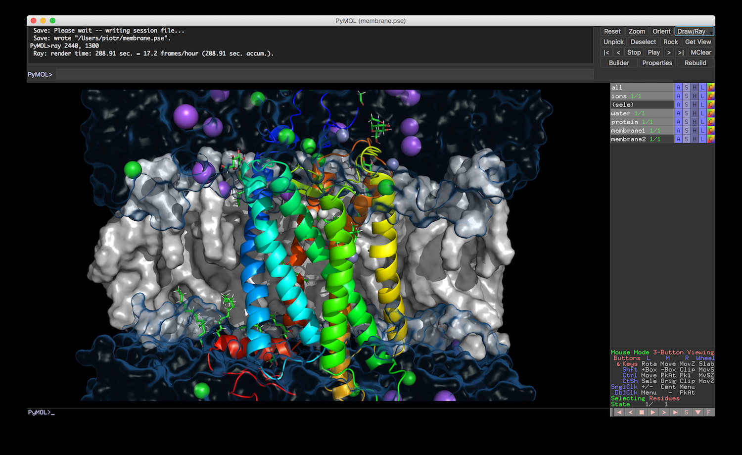
-Globally, there is programming that recognizes the sequence of protein data directly from the PDB.
PDB is a database for the three-dimensional structural data of large biological molecule.
This database can be visualized through molecular visual systems such as pymol, where 3D modeling is possible by computer.

Slide 4
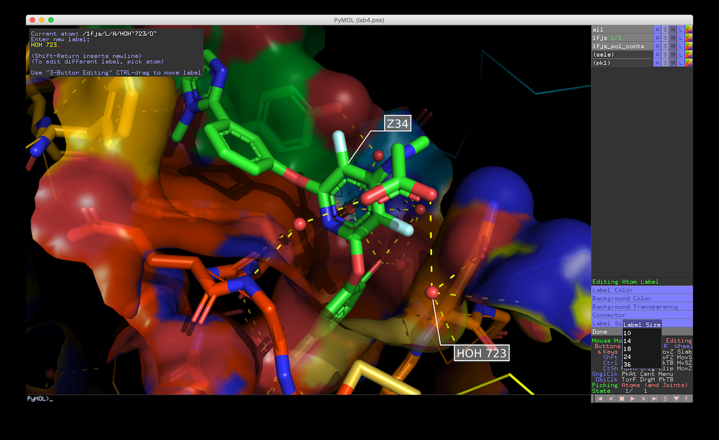
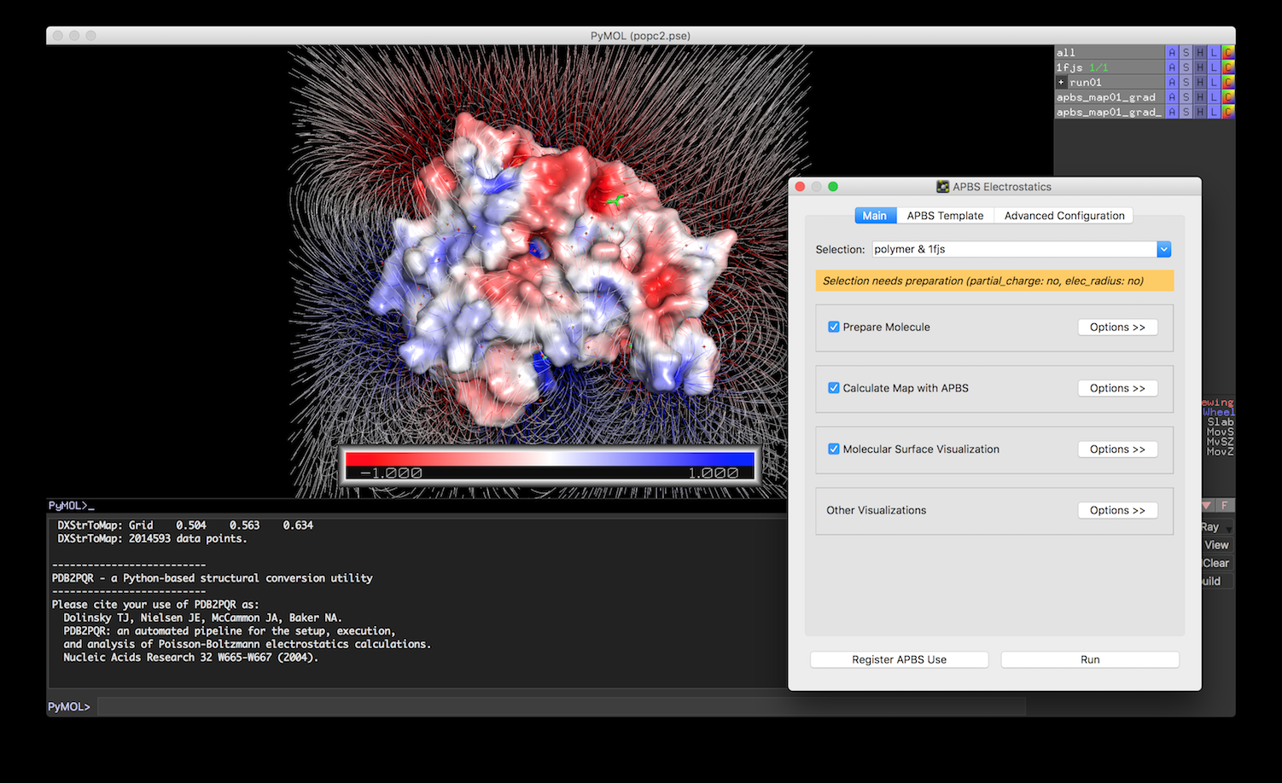
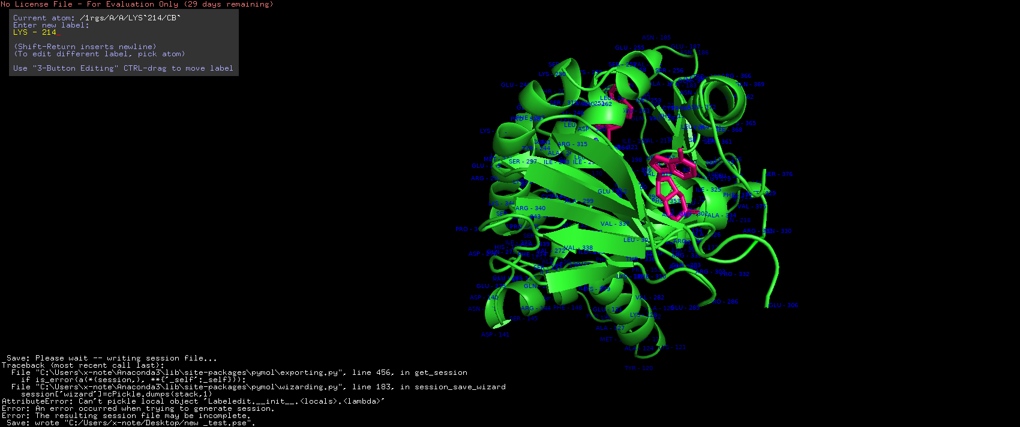
connecting the microscope to the previously mentioned software→ manual work will significantly decrease
prediction automatically done according to the molecule database saved within
Observation of changed protein models, measurement of modification of each virus and bacteria based on AI technology have been introduced and utilized in the structural biology field recently.

Slide 5
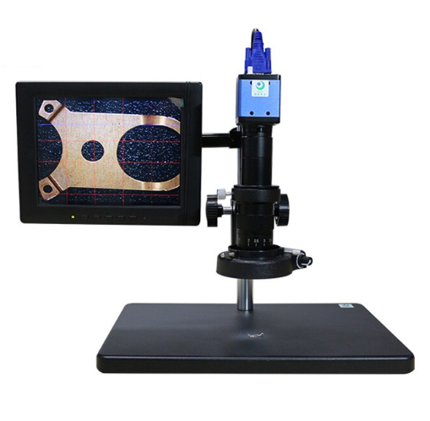
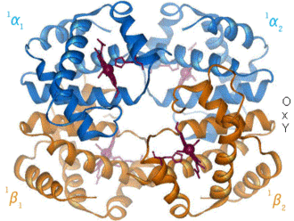
Even without human beings, the AI-electronic microscope will store, analyze and predict the data on its own and keep the information available to the researchers.
Introducing this AI microscope will lead a paradigm shift in the field of bioinformatics.
-Thank You-

